Slide 2
Modelling Sequences
How to work with data that has a temporal dimension?

Slide 3
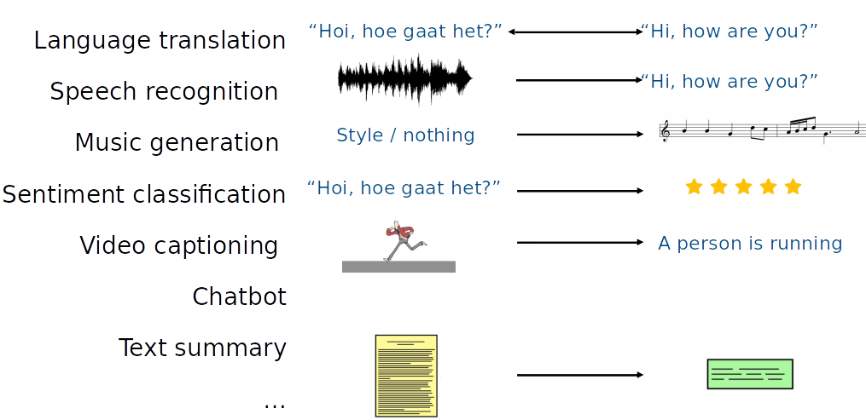
Modelling Sequences

Slide 4
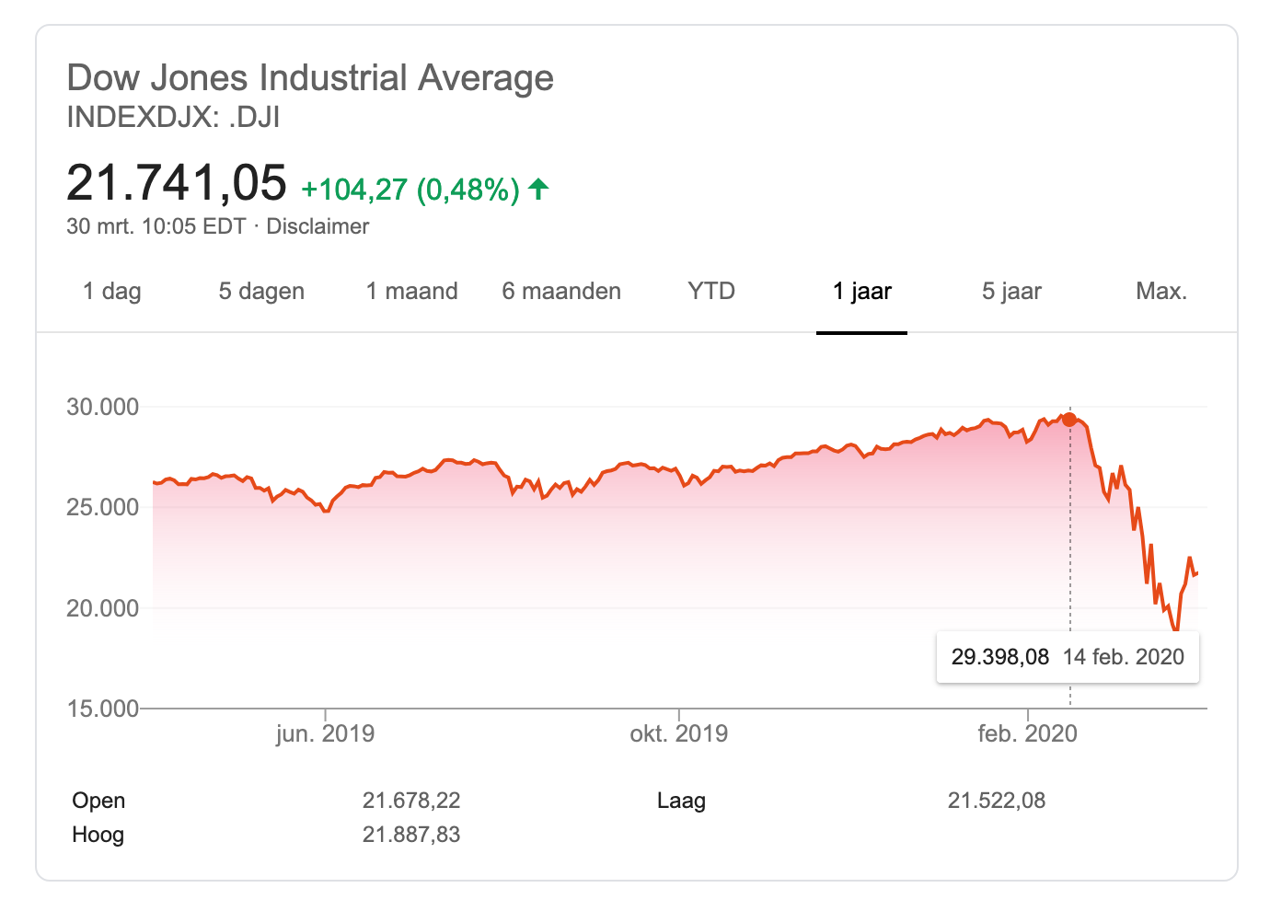
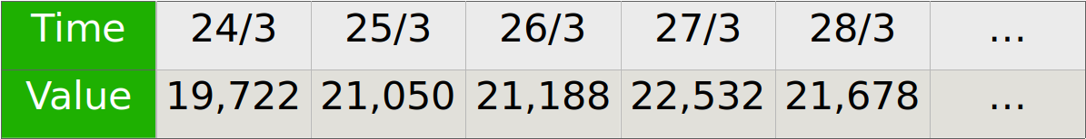
Sequential Data
Sequential Data are represented with 1d or 2d arrays

Slide 5
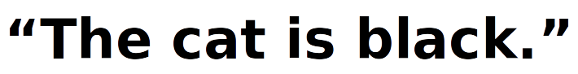
Sequential Data
Sequential Data are represented with 1d or 2d arrays

Slide 6
Sequential Data
Sequential Data are represented with 1d or 2d arrays
In Natural Language Processing (NLP)
Words converted into tokens
Token is represented numerically
Sentence is a sequence of tokens
Tokens may be logically related to each other

Slide 7
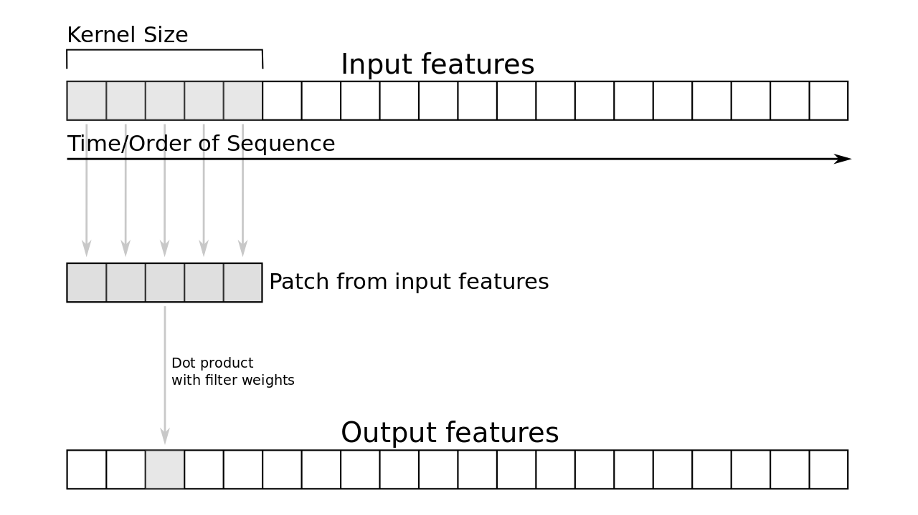
Sequence modelling with 1D convolutions
CNNs work here because they take into account nearby tokens

Slide 8
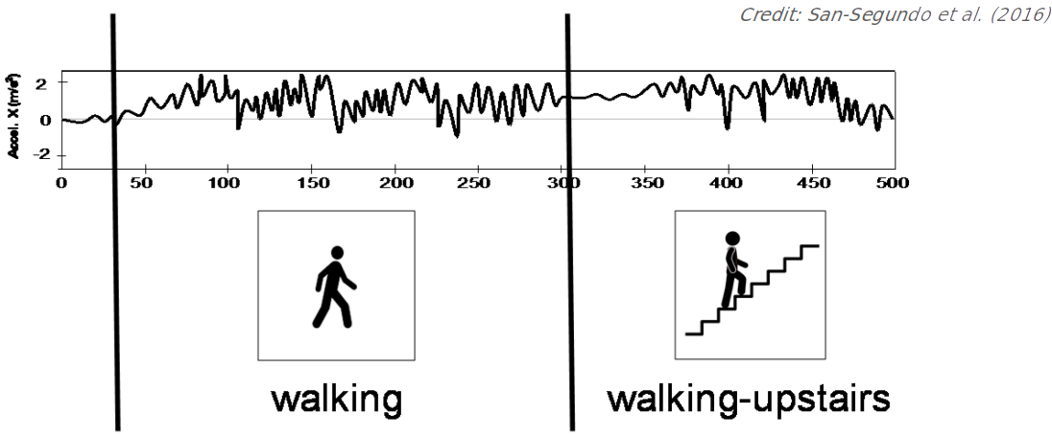
Human Activity Modelling with CNNs
CNNs work here because they take into account nearby tokens

Slide 9
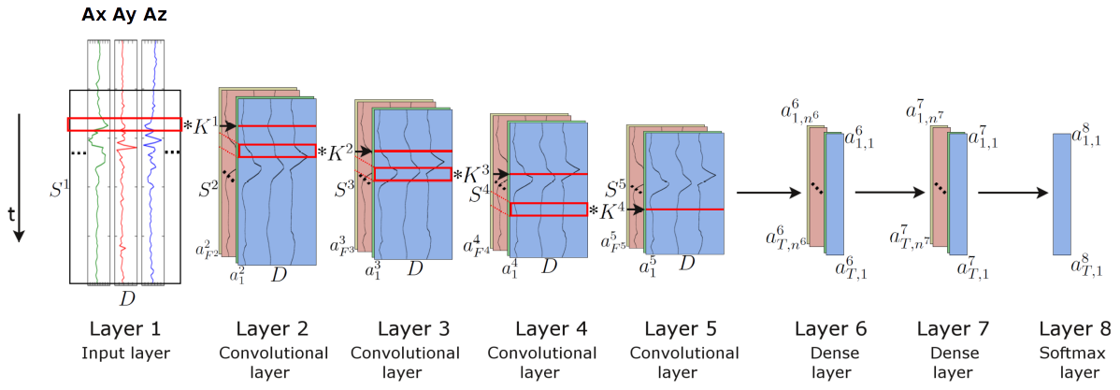
Human Activity Modelling with CNNs

Slide 10
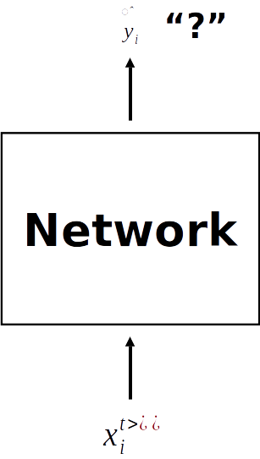
Natural Language Processing
“?”
Donald

Slide 11
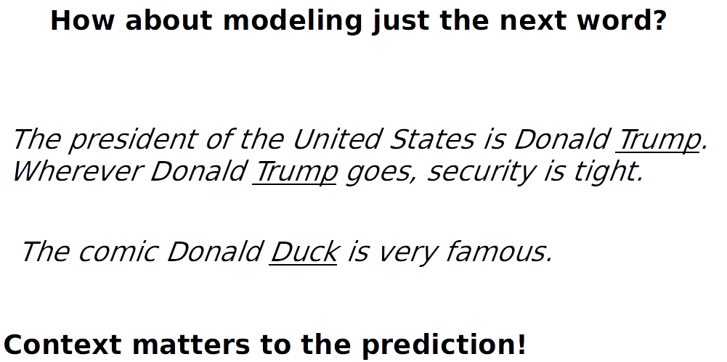
Natural Language Processing
“?”
Donald

Slide 12
Natural Language Processing
The meaning of the sentence depends on the context
“Donald”
Comic

Slide 13
Natural Language Processing
The meaning of the sentence depends on the context
The context is propagated to the next time step via the hidden state.
“Donald”
Hidden state
Comic

Slide 14
Natural Language Processing
The meaning of the sentence depends on the context
The context is propagated to the next time step via the hidden state.
The next prediction is then modelled with both the hidden state and the next word
“Donald”
“Duck”
Hidden state
Comic
Donald

Slide 15
Natural Language Processing
The meaning of the sentence depends on the context
The context is propagated to the next time step via the hidden state.
The next prediction is then modelled with both the hidden state and the next word
“Donald”
“Duck”
Hidden state
Comic
Donald

Slide 16
Natural Language Processing
The meaning of the sentence depends on the context
The context is propagated to the next time step via the hidden state.
The next prediction is then modelled with both the hidden state and the next word
The hidden state allows the network to have memory
“Donald”
“Duck”
Hidden state
Comic
Donald

Slide 17
Natural Language Processing
The meaning of the sentence depends on the context
The context is propagated to the next time step via the hidden state.
The next prediction is then modelled with both the hidden state and the next word
The hidden state allows the network to have memory
“Donald”
“Duck”
Hidden state
Comic
Donald

Slide 18
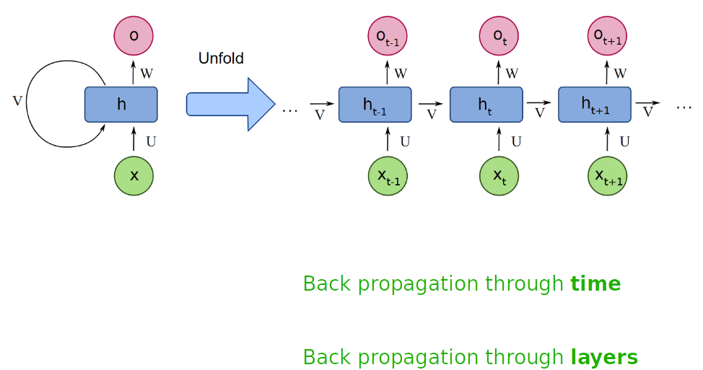
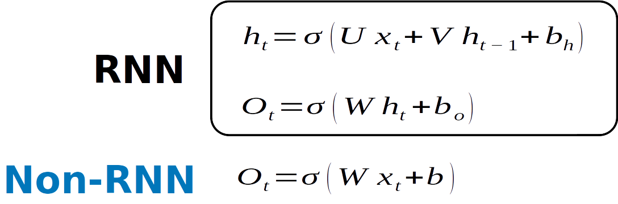
Recurrent Neural Network
In RNNs, weights are reused across time steps

Slide 19
Long-term Dependency
Sometimes, the contexts are far away
The clouds are in the sky
I grew up in The Netherlands … I speak fluent Dutch

Slide 20
Long-term Dependency
Sometimes, the contexts are far away
The clouds are in the sky
I grew up in The Netherlands … I speak fluent Dutch

Slide 21
Long-term Dependency
Sometimes, the contexts are far away
The clouds are in the sky
I grew up in The Netherlands … I speak fluent Dutch

Slide 22
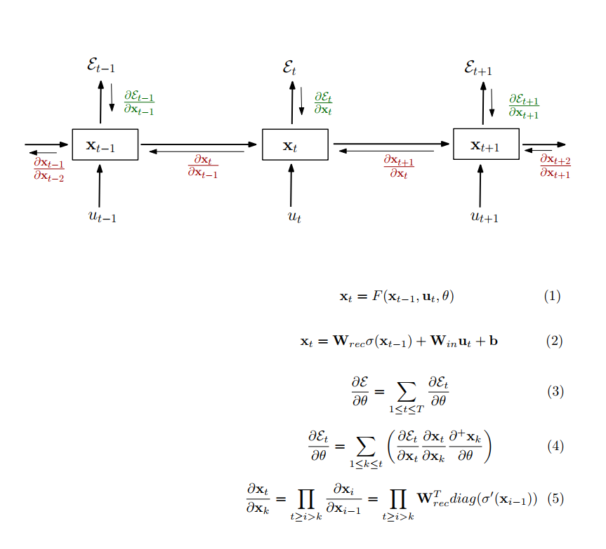
Long-term Dependency
Sometimes, the contexts are far away
The clouds are in the sky
I grew up in The Netherlands … I speak fluent Dutch

Slide 23
Long-term Dependency
Sometimes, the contexts are far away
The clouds are in the sky
I grew up in The Netherlands … I speak fluent Dutch
If is < 1, in a long product, gradients
start to vanish

Slide 24
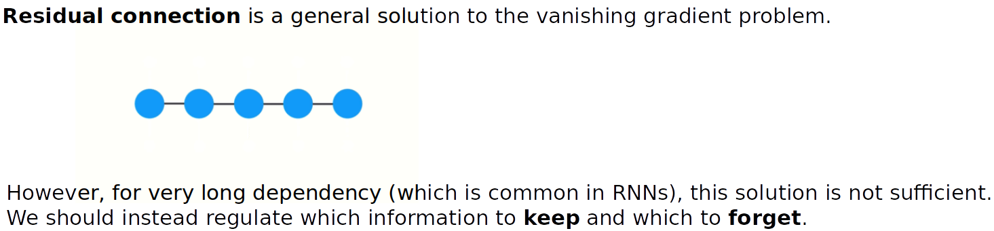
Long Short-term Memory
+
+

Slide 25
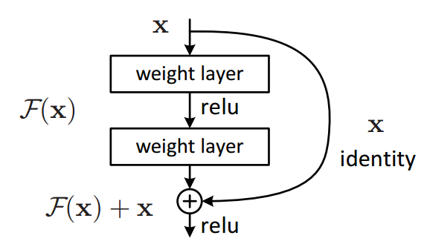
Long Short-term Memory
+
+

Slide 26
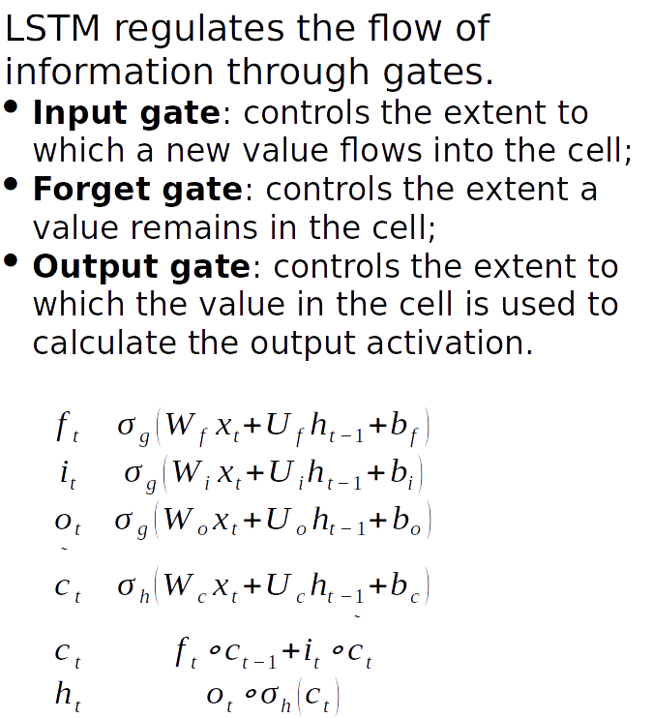
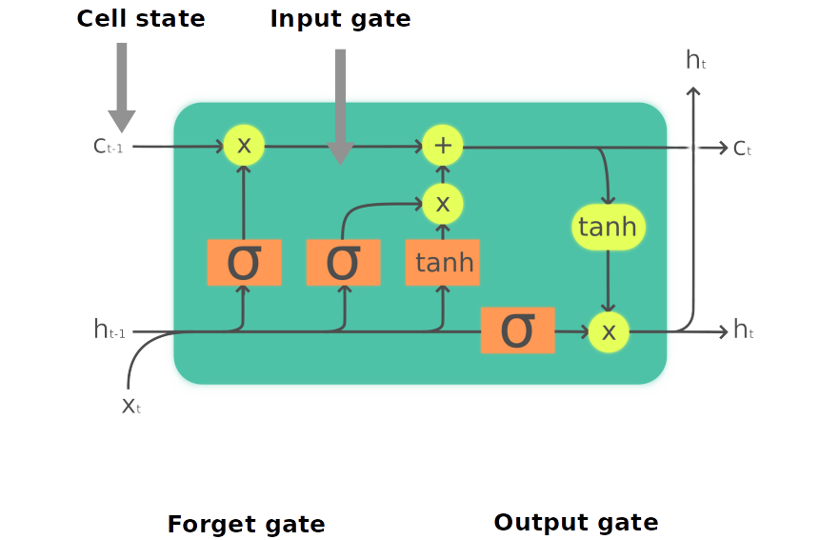
Long Short-term Memory
LSTM

Slide 27
Sequence Modeling
LSTM
BISHOP OF ELY:
Marry, and will, my lord, to weep in such a one were prettiest;
Yet now I was adopted heir
Of the world's lamentable day,
To watch the next way with his father with his face?
ESCALUS:
The cause why then we are all resolved more sons.
https://www.tensorflow.org/text/tutorials/text_generation

Slide 28
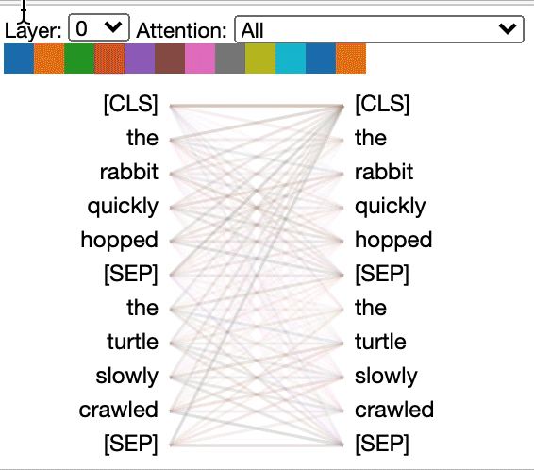
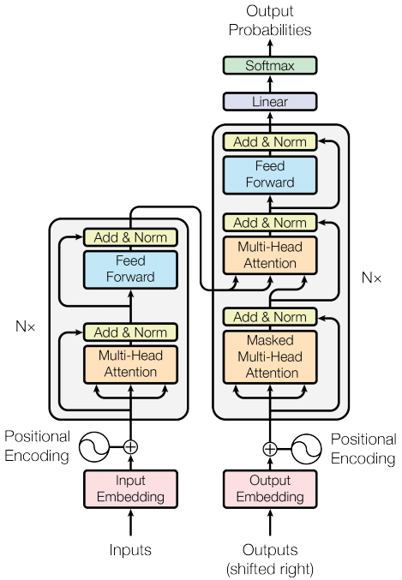
Self-Attention and Transformers
https://www.tensorflow.org/text/tutorials/text_generation

Slide 29
Sequence Modeling
Transformer: GPT-3
The unicorns told the scientists that they had left the valley to explore the world, but that after years of traveling the world, they found humans to be incredibly stupid and decided to return to the valley to lve in peace.
“We were shocked”, said Dr. St. maurice. “We had no idea that the unicorns had been waiting for us. We also had no idea that the unicorns were capable of speech. It was a truly magical moment.”
https://www.buildgpt3.com/post/88/
https://openai.com/api/

